Slide 1

Finding the Data You Want

Slide 2
Learning Objective
Be able to find data on the WRDS platform.

Slide 3
Assignment
Become familiar with data categories and vendors on WRDS.
Use the WRDS platform to find specific data items.

Slide 4
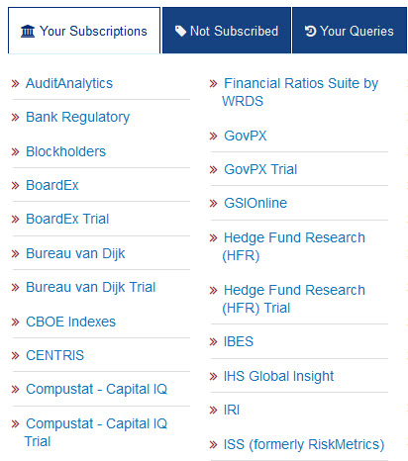
How is Data Categorized?
By Vendor:
Multiple data vendors make their data available on WRDS. Each vendor typically offers more than one database. For example, Compustat has the following databases:
Company fundamentals (e.g., financial statements)
Credit ratings
Executive compensation
As well as others

Slide 5
Data Organized By Vendor
While vendors tend to focus on different types of data, there is often overlap between vendors. Factset, for example, also has fundamentals data.
You can see WRDS’ vendor categorization by clicking the Get Data tab and then clicking on Vendors.

Slide 6
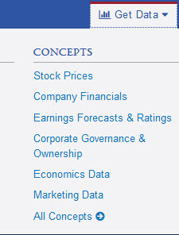
Data Organized by Subject
By Subject:
WRDS has also categorized the data on its platform by subject matter concept. For example:
Stock Prices
Company Financials
Earnings Forecast and Ratings
Corporate Governance and Ownership
Economics Data
Marketing Data
You can find these subject-area categories by clicking the Get Data tab.

Slide 7
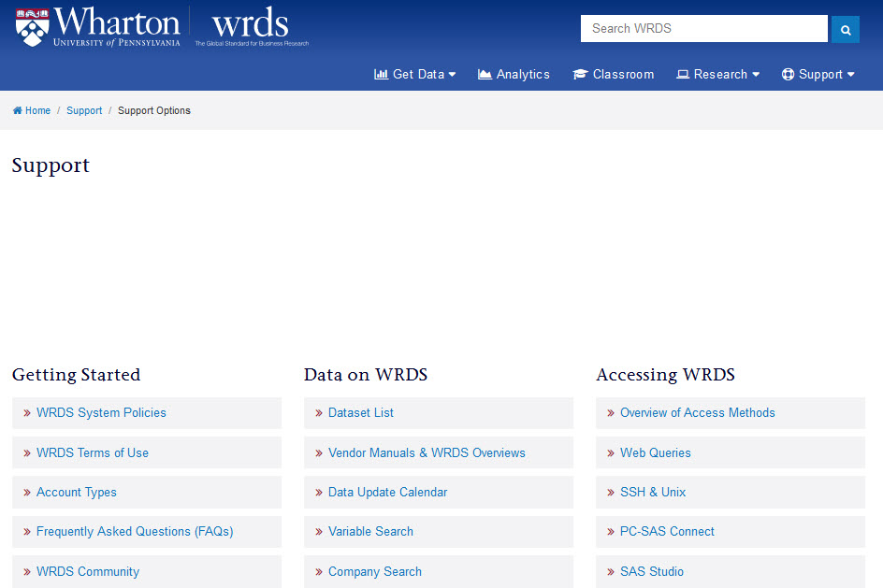
Help Me Find My Data
For additional help, click the Support tab.

Slide 8
How Can I Find Specific Data?
Most often, a researcher will be looking for specific pieces of data, such as …
Bid and ask prices for certain stocks at certain times
Board member salary
Mutual fund percentage ownership of a company
Operating expenses of a given company or set of companies
Without knowing, either the vendor or the general subject-area, how does one find this data?

Slide 9
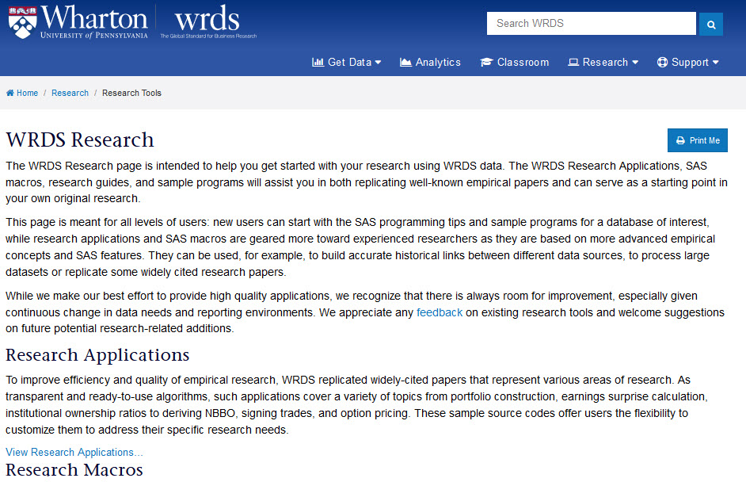
Research Tab

Slide 10
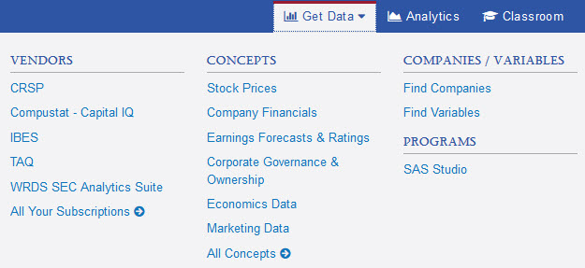
Using a Variable Search
To find variables, click the Get Data tab and then click the Find Variables link.

Slide 11
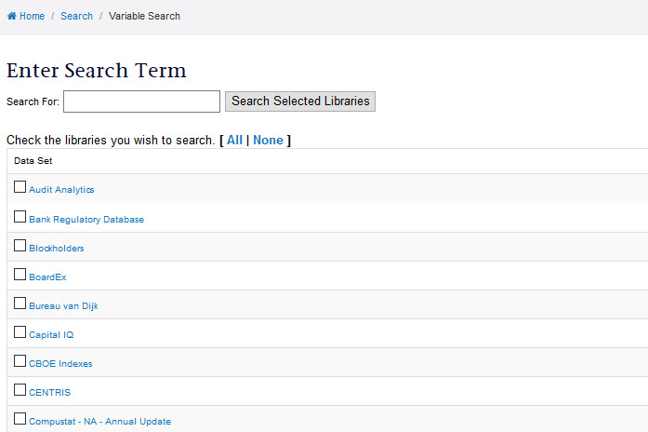
Variable Search

Slide 12
Dataset vs. Web Form?
Search variable via the dataset form will show you the underlying table within which the data is stored. For advanced users, this can be useful.
For most users, quickly finding the web form from which the variable(s) can be queried is the most useful.

Slide 13
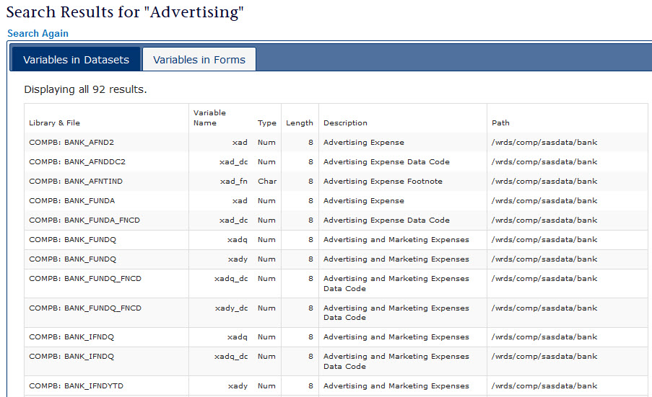
Variables in Web Forms

Slide 14
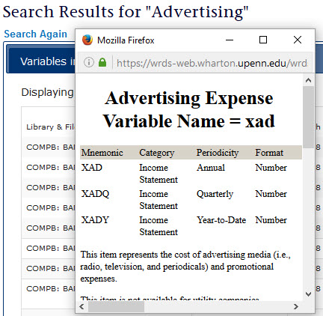
Details About Search Variables
Within the search results, clicking on the Variable Name will open a window with a more detailed description of the variable.

Slide 15
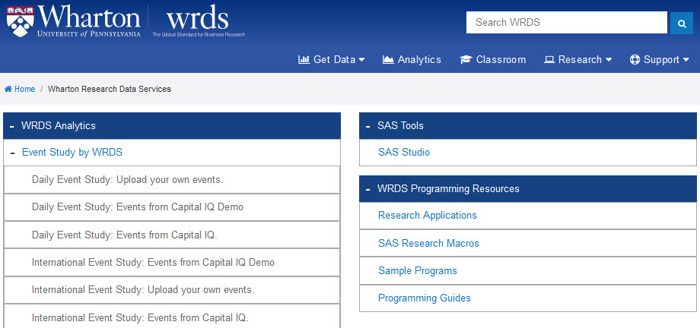
Additional Data Tools: Analytics
Click the Analytics tab to access a set of tools specifically designed to support research.

